Slide 1
Introduction to Water Filtration
Matthew Katterman

Slide 2
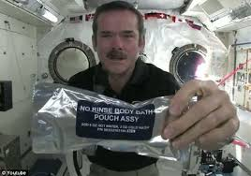
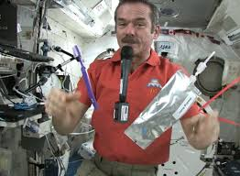
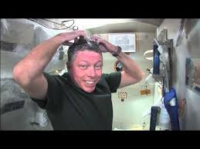
How do astronauts clean themselves in outer space?
Washing Hands
Brushing their Teeth
Washing Hair
No Rinse Body Bath
(Soap with water in it)
Toothbrush, Toothpaste
Pouch of water
Shampoo, Water
and Towel

Slide 3
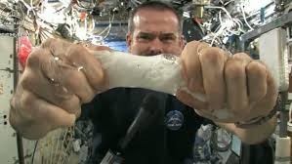
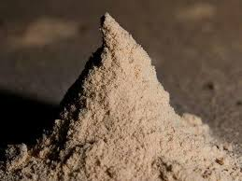
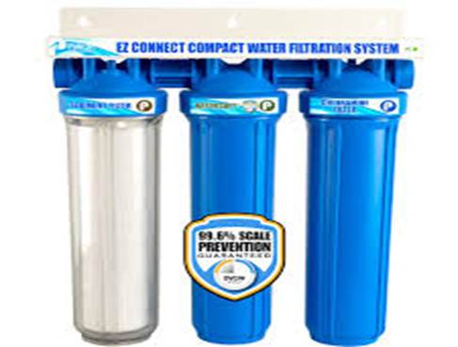
Wastewater needs Filtration
Still Need to Filter out
Skin, Hair and Dust
From the Water.
Cleaning the Body
Use a Space Towel
(Wring out Towel)
Requires A Filtration
System

Slide 4
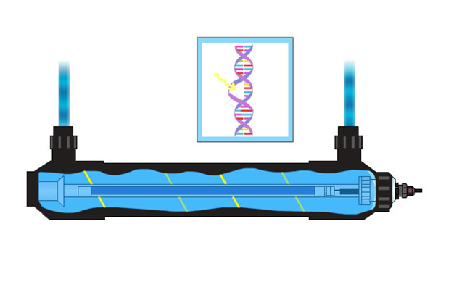
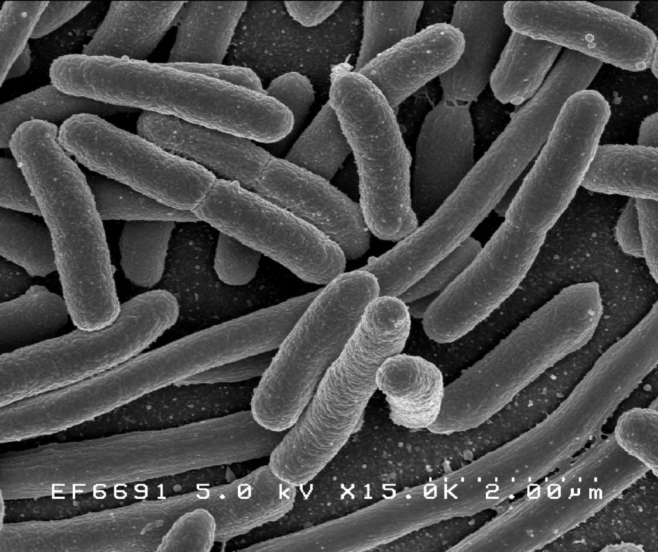
Possible Germs in Water
Possibility that water could contain bacteria or germs.
Must be removed when cleaning the water.
UV filtration is one way of doing this.
Isopurewater.com

Slide 5
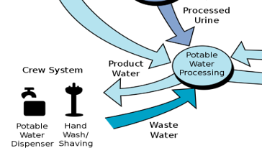
Water Recovery and Management System
Reuses water from waste sources and air vapor. Kills & removes microbes in water. Recycles water from urine.

Slide 6
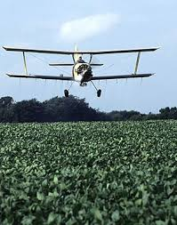
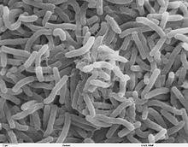
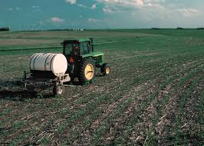
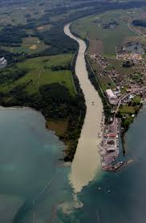
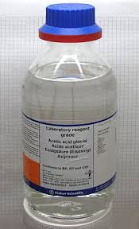

Water requires cleaning on Earth because of pollutants
Organic
Pathogens
Nutrient
Suspended Solids
Inorganic
Radioactive

Slide 7
Wastewater Treatment Plant Stages
A Wastewater Treatment Plant has 3 Stages
Primary Treatment (First Stage)
Secondary Treatment (Second Stage)
Tertiary Treatment (Third Stage)

Slide 8
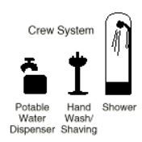
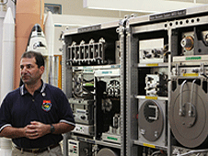
Water Treatment on a Space Station
Process (Clean, Purify)

Slide 9
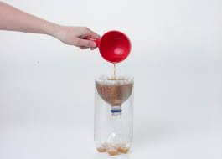
Simple Filtration System to Clean Dirty Water
You will build a simple water filtration system
to clean dirty water using sand, gravel, coffee filters
and cotton balls.

